Slide 1
Deliverables
1. Business Proposal Report in .pptx format. The following needs to be covered:
• Clear visual analysis, graphs & charts to show understanding on dataset / features
• Model & Methodology of Machine Learning Model used
• Accuracy measure of ML model and justification of metric selection
• Solution proposals on how business should employ the ML model and insights in an operational context
• Any assumptions used for formulation
• Please keep the report to a maximum of 30 slides. Any slides above that will not be assessed.
2. Python Notebook in .ipynb format
• All graphs, charts, model and accuracy score needs to be shown in the submitted Juypter notebook
• Comments and Insights in the notebook will NOT be taken into account and these should be incorporated in the PowerPoint rep

Slide 2
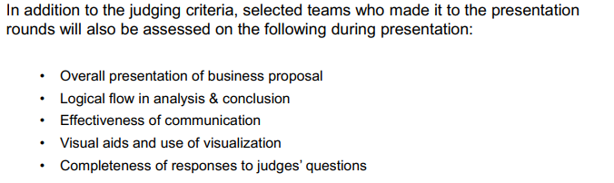
Additional Areas of Assessment during Presentation

Slide 3
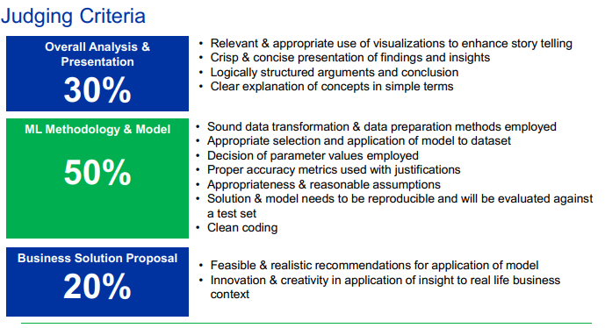
Judging Criteria

Slide 4
Company: 25Credit
Company: Global Credit Card Company
Issues:
-Annual $10 million fraudulent transactions
-Significant costs and effort in the investigation and management of these transactions (lag time from occurrence of the fraud to the reporting)
-Hard to recover the full amount from transactions due to time lapse
Objective:
-find solutions to reduce time and effort for investigation
- improve on the fraud recover through early identification and proactive management of suspicious transactions

Slide 5
-Analysis & Understanding of the Current Problem and Data
-Technical ML model
-Recommendations on Integrating the insights into action plans / solutions to tackle 25Credit’s business challenges

Slide 6
Naive Bae-s

Slide 7
Exploratory Data Analysis (5 Slides)

Slide 8
Data Preprocessing (5 Slides)
Missing Value Pattern Analysis and Multiple Imputation
Outlier Analysis
Feature Re-engineering
Feature Selection
Data Resampling

Slide 9
Classification Model Selection (7 Slides)
Proposed Models
Parameter Selection
Assumptions
Evaluation Metrics

Slide 10
Model Comparison (3 Slides)
Comparison on different models based on evaluation metrics
Final Model Selection
Limitation of Models and Mitigations

Slide 11
Recommendation (8 Slides)
Soulution 1
Solution 2
Solution 3

Slide 12
Conclusion (1 Slide)

Slide 13


25Credit
9872 4908 2345 9898
1234
VALID TILL 12/19
Team: NAÏVE BAE-S

Slide 14
Introduction
What are the different types of credit card fraud?
Bankruptcy fraud
Theft fraud/ counterfeit fraud
Application fraud
Behavioural fraud
Authorisation or verification fraud
Chargebacks or refund frauds
Detecting suspicious orders
To begin with, fraud emerges from many different facets; no one solution is likely to be the “holy grail” at this point in time. Throwing more resources at the problem may not be the solution if this doesn’t combat fraud from the different facets of identity verification, identity authentication and transaction risk. Therefore, organisations should consider some combination of automated transaction scoring/rules and logic filtering, real-time transaction tracking, transaction / customer verification and authentication, geolocation and/or device identification.

Slide 15
Introduction
Need for Speed: In today’s world, banks, processors, merchants no longer:
Are aware of all the possible attacks(channels, sources and types): models are generally good at tracking down know cases of fraud, but not good at tracking new emerging types of frauds
Have the luxury of time: Fraudsters take advantage of fast card transactions and get away with fraud
Interpret all the data: most fraud solutions cannot ingest data without expensive and time consuming solutions integration.
These gaps are being violated by fraudsters. Hence, it’s important to take a multi-faceted approach for detecting fraud.

Slide 16
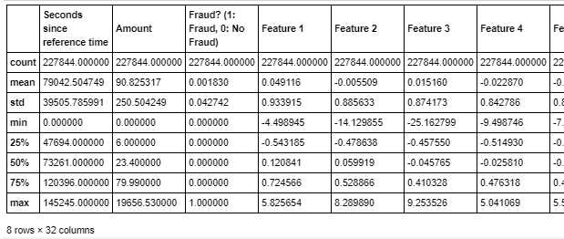
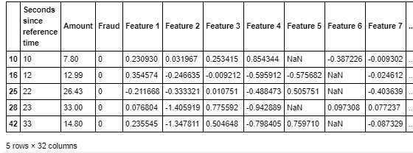

Exploratory Data Analysis
Summary Statistics
- Features columns are generally similar in values range (due to PCA transformation)
- Seconds since Reference Time & Amount have different scale.
Missing Values
- Presence of Missing Values in 2 columns: Features 5 and 6
Duplicated Values
- No duplicated Values

Slide 17
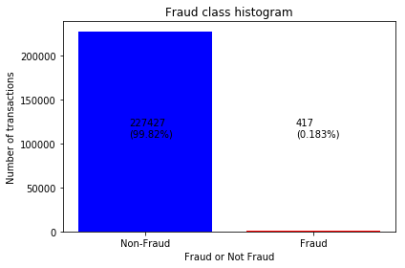
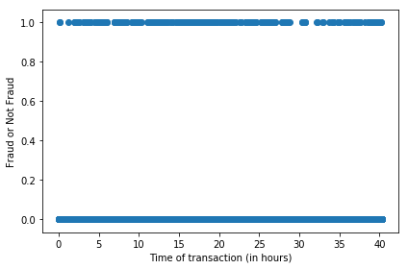
EDA
Fraud Class Analysis
Fraud Class Histogram
Scatter Plot of Fraud Class & Transaction Time
- indication of significant unbalance between data points for class “Fraud” and “Non-Fraud”
-Pattern for both non-fraudulent and fraudulent transactions seems to be random regardless of hour of the day
Need to conduct resampling
“Seconds Since Reference Time” not a good predictor
Notes:
Fraud Class Analysis
Fraud Class Histogram
Scatter Plot of Fraud Class versus Seconds since Reference Time
Scatter Plot of Fraud Class versus Transaction Amount
Line Graph of Density of Probability for Fraud Class versus Transaction Amount

Slide 18
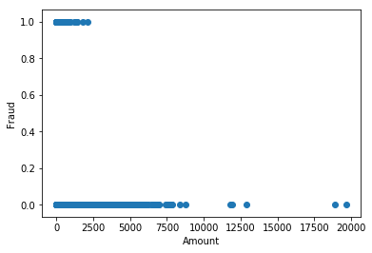
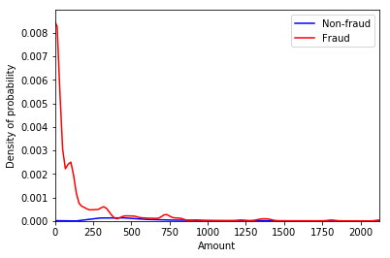
EDA
Fraud Class Analysis
EDA
Scatter Plot of Fraud Class & Transaction Amount
Line Graph of Density of Probability for Fraud
Fraudulent transactions more concentrated towards lower amount (<2500)
Density of probability for fraud is much higher for lower amount & it increases as the amount lowers

Slide 19







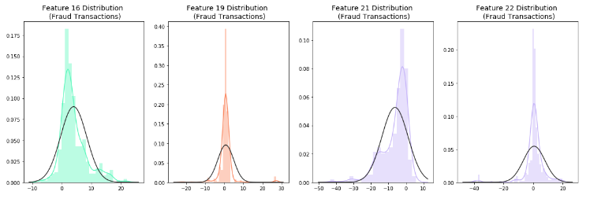
EDA
Anomaly/Outlier Detection
EDA
EDA
Feature 16
Feature 19
Feature 21
Feature 22
Rationale for not Removing Outliers
Outliers are value adding for fraud detection classification model
Notes:
Since Feature 16, 19, 21 and 22 has much higher range (between 76 to 95) as compared to the rest, we will check for the distribution plot of these features.
Even though the features contains outliers, these outlier values adds value to the fraud detection classification model

Slide 20
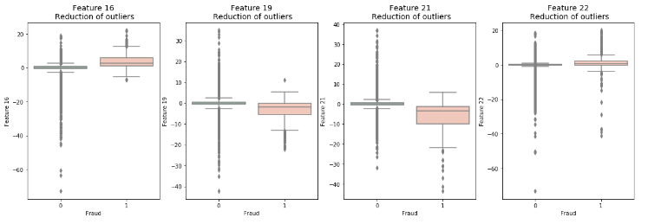
EDA
Anomaly/Outlier Detection
EDA
EDA
Feature 16
Feature 19
Feature 21
Feature 22
Rationale for Not Removing Outliers
Outliers values are present in both “Fraud” and “Non-Fraud” class labels If we remove the 75 Fraud outliers, our dataset will become more imbalanced

Slide 21
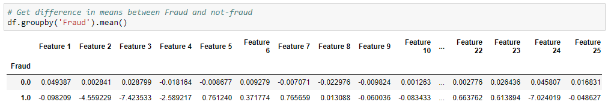
EDA
Insights from EDA
EDA
EDA
Feature 3
Feature 24
As we can see, certain variables (like `Feature 3`, and `Feature 24`) are drastically different for fraud and non-fraud categories. The company can keep these Features in view for early fraud detection analysis.

Slide 22
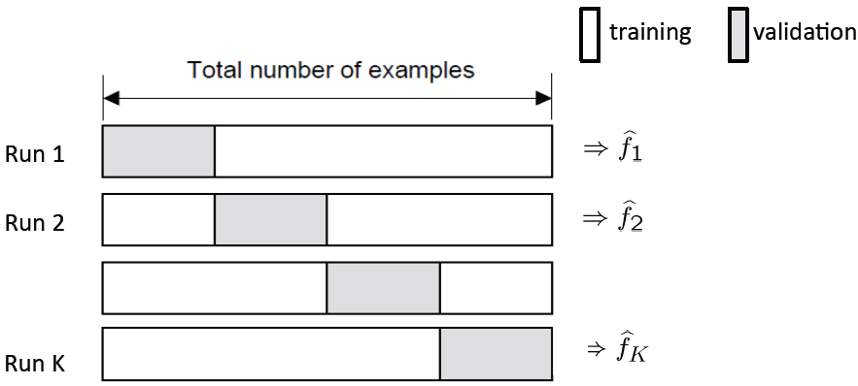
Splitting of Dataset
Train Set
Test Set
70%
30%
K-fold Cross-Validation
Test Set: to be used for model evaluation metrics
Training Set: used for model training while k-fold cross validation is used for parameter tuning
Notes:
Source: https://towardsdatascience.com/train-validation-and-test-sets-72cb40cba9e7

Slide 23
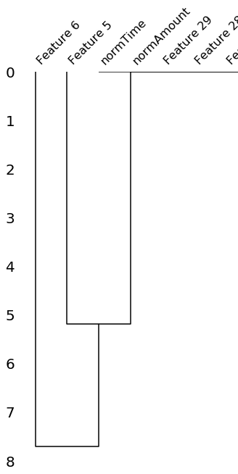
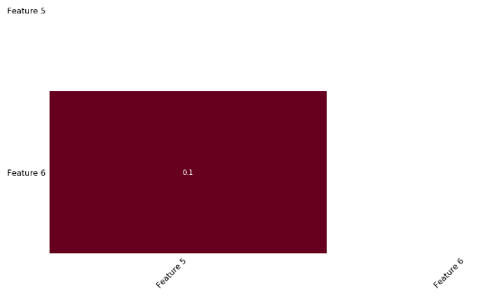
Data Cleaning – Missing Values
NULLITY CORRELATION MATRIX HEATMAP + DENDROGRAM
F5
F6
F5
F6
Marginal Correlation (0.1) bet the presence of absence of F5 & that for F6
THIS PART CANNOT UNDERSAND YET
Notes:
The missingno correlation heatmap measures nullity correlation: how strongly the presence or absence of one variable affects the presence of another. In this case, it shows that only Feature 6 and 5 are missing and there is a 0.1 correlation between the missing values in these two columns.
Dendrogram interpretation:

Slide 24



Data Cleaning – Missing Values
CHECK FOR PRESENCE OF MISSING VALUES
Feature 5
Feature 6
Only Feature 5 and 6 has missing values while the percentage of missing values over whole dataset is below 3%
Data NOT Missing Completely at Random (MCAR)
Hard to distinguish bet Missing at Random (MAR) and Missing Not at Random (MNAR)
Features definition and contexts are unknown
SOLUTION : MULTIPLE IMPUTATION (using sklearn by mean values)
Notes:
Dropping the rows will make the model biased and we will be using Imputation instead

Slide 25
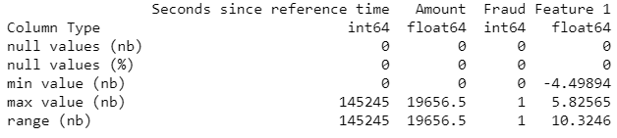
Data Transformation - Normalization
CHECK FOR ATTRIBUTE VALUES RANGE
Seconds Since Reference Time
Rational for Normalization
Time Sequence
Wide Range
adds additional weight on the features for prediction model building
Amount
Wide Range
Notes:
Since the value of amount and time have a very different scale from the rest, we should consider normalising the columns "Amount" and "Seconds since reference time"

Slide 26

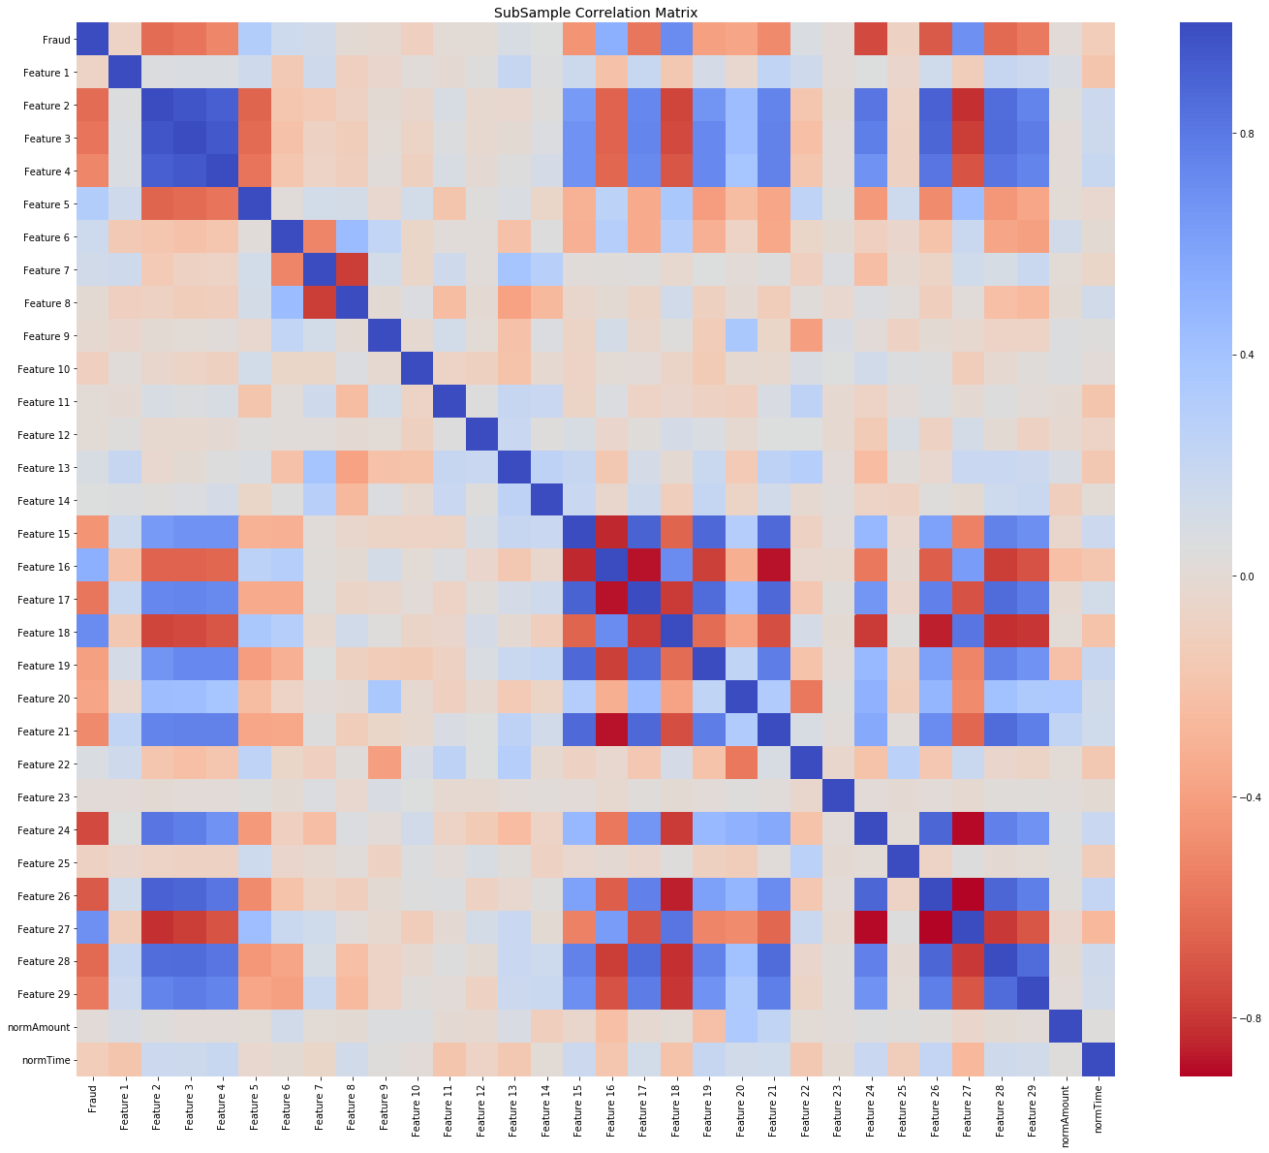
Feature Selection
Data Shuffling
Correlation Matrix
Random Forest
Step Forward Feature Selection
Parameters
No of Trees: 1000 K_features: 17
Scoring: Accuracy
Parameters
Normal Distribution
Frac: 1
Random_state: 42
Remove Features with high positive or negative correlation
[Features 7, 16, 27, 2, 21]
Selected Feature:
0, 1, 2, 4, 6, 8, 9, 10, 11, 14, 15, 17, 18, 19, 20, 21, 23
Minimize bias and patterns in the training dataset
Notes:
Data Shuffling: avoid element of bias / patterns in the split datasets (after splitting into training, testing and validation datasets) before training the ML model and subsampling → Improve ML model quality + Improve predictive performance
Correlation Metrics:
Negative Correlations: Features (7 and 8), (15 and 16), (16 and 17), (16 and 21), (24 and 27), (26 and 27) are negatively correlated.
Positive Correlations:Features (2,3, and 4), (2 and 26), (15 and 21) are positively correlated. Notice how the higher these values are, the more likely the end result will be a fraud transaction.
So now we will be removing features 7, 16, 27, 2, 21

Slide 27
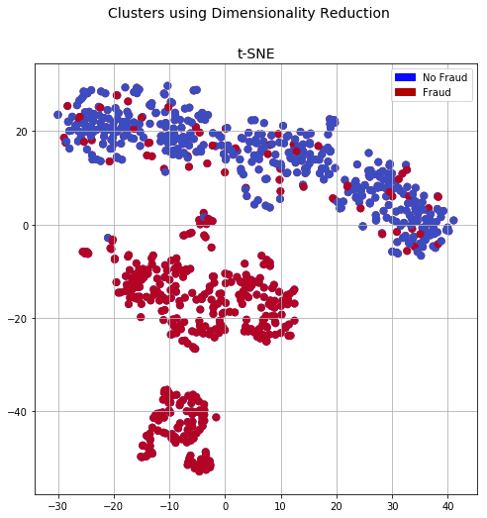


Data Resampling
T-distributed Stochastic Neighbour Embedding
Synthetic Minority Over-sampling Technique
Nonlinear Dimensionality Reduction Technique for Visualization of Clusters
Higher Performance than Conventional Oversampling and Undersampling
Parameters
Sampling Strategy = 0.67
Kind = regular
Parameters
N_components = 2
Random_state = 42
Notes:
t-SNE tells us if our prediction model will correctly able to cluster our training set datapoints correctly. From the plot above, we can see that the data can be classified into fraud and non-fraud and thus, we will be moving forward with it N_component = 2 because 2 classes., Random_state=42 so it's easy to re-run and test
SMOTE: it creates synthetic (not duplicate/replicate) samples of the minority class. Hence making the minority class equal to the majority class. SMOTE does this by selecting similar records and altering that record one column at a time by a random amount within the difference to the neighbouring records.

Slide 28
Data Transformation
Classification Model
Ensemble Methods Model
Bagging: Random Forest
Logistic Regression
Decision
Tree
Notes:
SVM: not suitable for large datasets because of its high training time

Slide 29
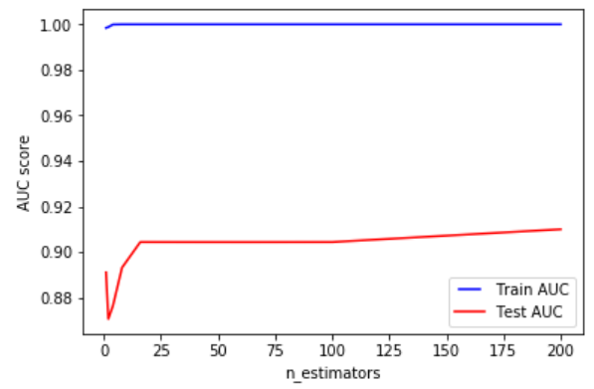
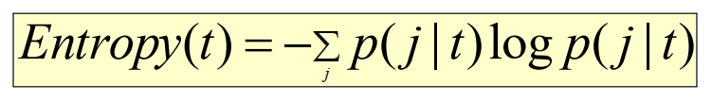
Bagging – Random Forest
Parameter Consideration
N_estimator: 24
Splitting Criteria: Entropy
p( j | t) is the relative frequency of class j at node t
Reasons: Chose point when Test AUC starts to decrease over time
Reasons: Entropy gives better information gain than Gini Index and Misclassification Error

Slide 30

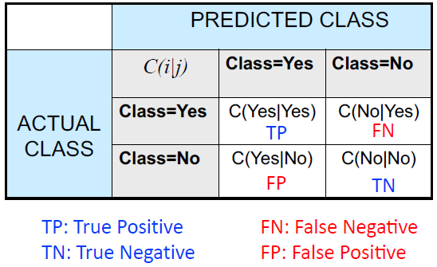
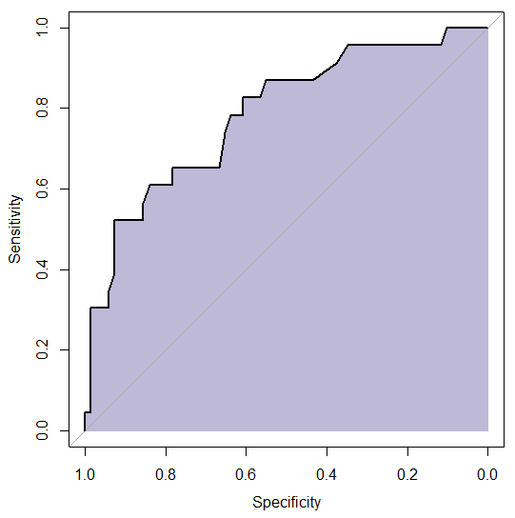


Evaluation Metric
Confusion Matrix
AUC Curve
Precision
Recall
F1-Score
2
2 TP
2 TP + FP + FN
Notes:
What evaluation metric we have chosen to evaluate our model and is it the most appropriate for the type of dataset?

Slide 31
Evaluation Metric
Accuracy
Inappropriate for imbalanced dataset due to higher likelihood in predicting the class label to be non-fraud
Precision
Shows fraction of relevant instances among retrieved instances → Inappropriate due to precision bias
Recall
Shows fraction of relevant instances over total relevant instances → Inappropriate due to recall bias
F1-Score
Balance no of fraud detected and minimize no of fraud falsely detected → Balance precision and recall trade-off
AUC
Suitable to evaluate binary classification model → Higher AUC means higher predictive power
Notes:
Accuracy
In appropriate for imbalanced dataset as the model will be more likely to predict the label to be non-fraud given the smaller number of fraud cases. Accuracy is used very specifically for the dataset with equal number of records for fraud and non-fraud.
Confusion Matrix - precision, recall, F-score
F-score: balance precision and recall trade-off
is calculated to balance the number of frauds detected and minimise the number of frauds falsely detected
Area under Curve
We will use AUC (Area Under Curve) as the evaluation metric for parameter tunings for our Random Forest model. As we are working on classification predictive model, AUC is a more appropriate way for evaluation.
Given a random fraud case and a random non-fraud case, proportion of the time the model predicts a higher probability of fraud care to the fraud-care case.

Slide 32
Model Evaluation
Model | Precision | Recall | F1-Score | AUC Score
Logistic Regression | 0.83 | 0.58 | 0.68 | 0.9556
Decision Tree | 0.36 | 0.8 | 0.49 | 0.897
Random Forest | 0.89 | 0.82 | 0.85 | 0.968
Final Classifier: Random Forest due to with high AUC score (0.968) and F1-Score (0.85)

Slide 33
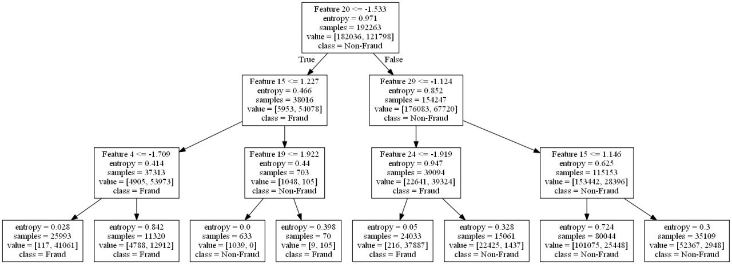
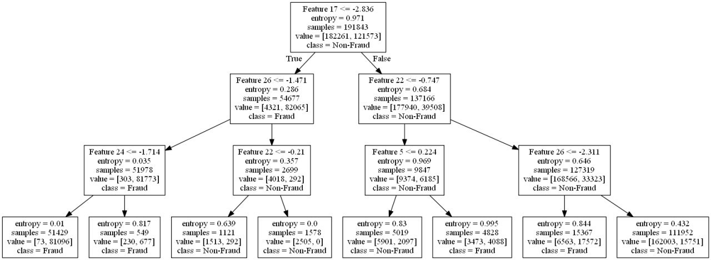
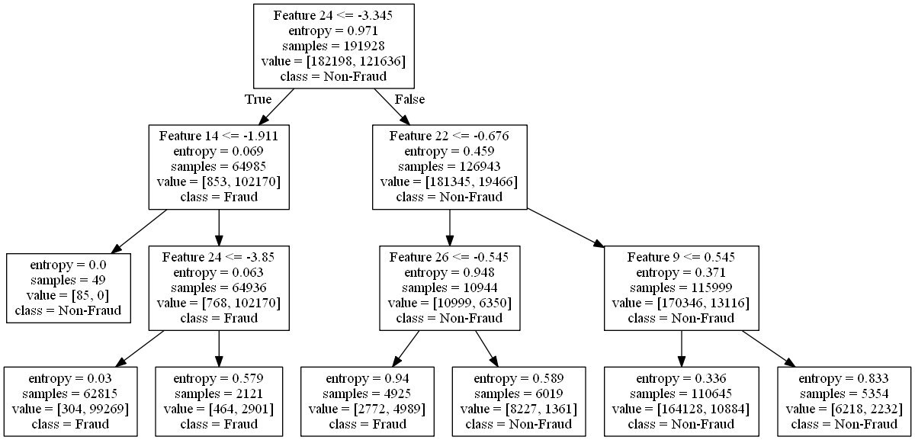
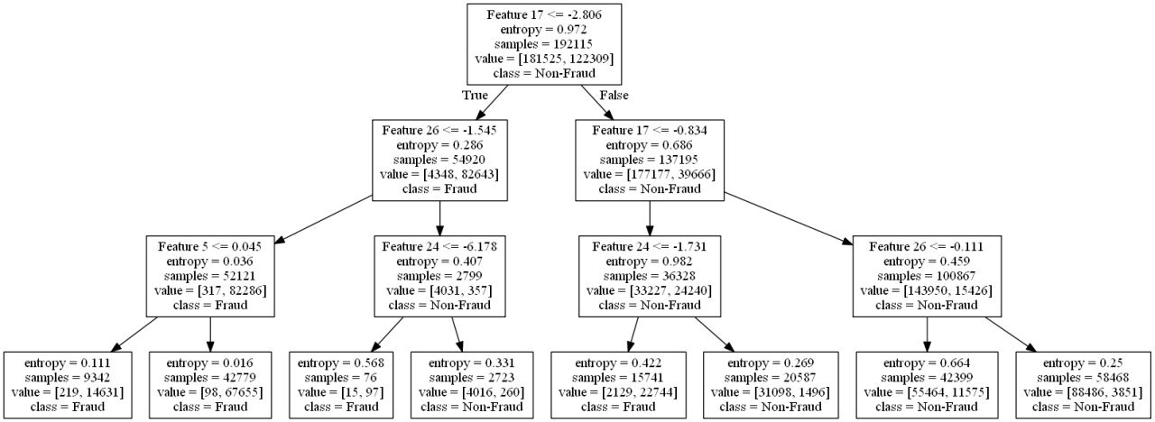
Bagging – Random Forest
4 trees are randomly printed
→Primary Indicator: low value for Feature 24 (<1/7) implies a Fraudulent transaction
Notes:
From the 3 decision trees w eselected randomly and printed, we found the following 2 insights:
1. Low value for Feature 24 (<-1.7) implies a Fraudulent transaction
Thus, we can keep an eye out for features 24 as preliminary indicators for fraud.

Slide 34
Bagging – Random Forest
3 trees are randomly printed
→Primary Indicator: low value for Feature 26 (-2) and 17(-2.8) implies non-fraudulent
Notes:
2. Low value for Feature 26 (-2) implies a non-Fraudulent transaction
3. Low value for Feature 17 (-2.8) implies a non-Fraudulent transaction rgb(22, 160, 133)
Thus, we can keep an eye out for features 26 and 17 as preliminary indicators for non-fraud.

Slide 35
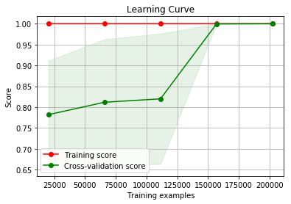
Futher Evaluation
Bias Variance Trade-off
Learning Curve
For final model, bias-variance trade-off is good due to merging of training and cross-validation score → robust and good model

Slide 36
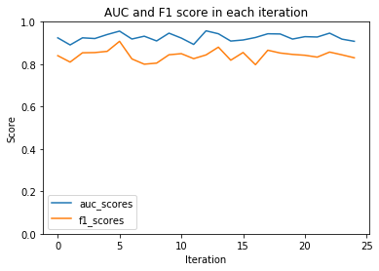
Futher Evaluation
K-fold Cross Validation
AUC & F1 Score for each of the 25 Iterations
Minimal fluctuations in F-1 and AUC scores → lack of overfitting / overfitting

Slide 37
Business Solution
Using predictive analytics in concert with rules based strategies is the best way to ensure all fraud — whether it’s known or unknown, fast moving or slowly evolving — is detected and prevented before losses accrue. However, there’s still a few questions to be answered.

Slide 38
Business Solution
First, let’s address the cost question.
The whole point of a fraud detection and prevention system is to reduce losses from fraud, especially when losses are increasing rapidly due to newer, faster methods of payment. The intuition is that managing fraud and knowing more about the customer and transaction can have a combined effect of increased sales and loyalty. However, the cost of controlling fraud is too high. That said, the losses associated with fraud, including lost customers due to false positives, could prove significantly more costly over time than solution investments to mitigate such issues in the first place.
An effective fraud mitigation solution should have low false-positive ratios. Higher ratios not only have an adverse impact on customer satisfaction but also increase the operational cost of managing fraud. It needs to balance customer satisfaction (by faster processing of the transactions) and minimizing the loss due to possible fraudulent transactions.

Slide 39
Business Solution
Secondly, the business case isn’t all about loss prevention. Banks, processors and merchants that implement the right fraud analytics solution can also reap significant improvements in customer service, and ultimately, their bottom line. This is because applying analytics to fraud detection enables consumers to have a better experience. Since the addition of analytics helps improve fraud detection while lowering the false positive rate, the banks and merchants gain greater customer loyalty as consumers are able to transact in confidence with less interruption. No consumer likes to deal with the fallout of their account falling victim to fraud. In the card industry, while the bank or processor will undoubtedly stop the fraud, cancel the card and send out a new one “in three business days,” the resulting inconvenience often erodes customer loyalty. 20% of consumers that experience fraud severed their relationship with their bank or merchant.

Slide 40
Limitations and Constraints
Anonymized features make it difficult to do feature engineering

Slide 41
Future Improvements
Model Stacking
Try Other Resampling Method
Try Other Models: K-NN, Naïve Bayes, SVM, Boosting: XGBoost, LightGBM, CatBoost, AdaBoost

